Slide 1
Artificial Intelligence:
The Science of Designing
Smart Systems
Raj Bhatnagar
Professor, School of Electronic and Computer Science
University of Cincinnati

Slide 2
What is Computer Science About?
O b s e r v a t i o n s
Store Massive Data
Smartly Process Massive Data
Make “Decisions” Using Data
Discover New Knowledge in Data
Hardware
Software
Decisions
Intelligent Actions
New Knowledge

Slide 3
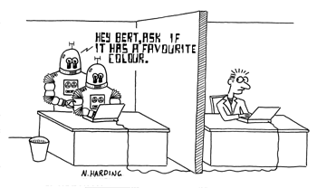
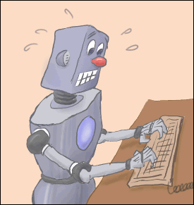
Turing Test
Alan Turing in 1950 proposed a test for machine intelligence:
  Natural Language Processing
  Knowledge Representation
  Automated Reasoning
  Machine Learning
Total Turing Test also includes:
  Computer Vision
  Mechanical movements
  Robotics Captures all the above tests.

Slide 4
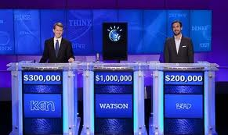
Very Smart Systems!!!
IBM’s “Watson” – won the Jeopardy championship
Link
WatsonForCancer
Computer:
- Knows everything
- Reasons
- Answers questions

Slide 5
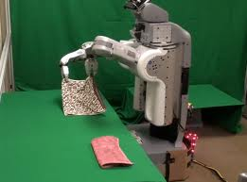
Very Smart Systems!!!
Towel folding robot
link
Computer:
- Sees
- Reasons, Strategizes
- Takes actions

Slide 6
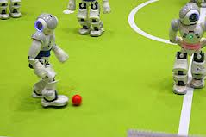
Very Smart Systems!!!
Robot Soccer Team
link
Computer:
- Sees
- Reasons, Strategizes
- Takes actions

Slide 7
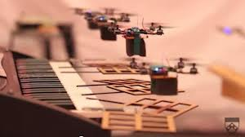
Very Smart Systems!!!
Flying Robots Play Music
link
Computers:
- See, cooperate
- Reason, Strategize
- Take actions

Slide 8
Robotic Surgery and Intelligent Software
Surgery of a grape
Stitch a grape back
Self-Driving Cars
Flock of Birds
Manufacturing Tesla Cars
Flight Simulator

Slide 9
“Smart” Computers: Massive Data
  The Large Hadron Collider experiments have 150 million sensors delivering data 40 million times per second.
  The Sloan Digital Sky Survey collects astronomical data at a rate of 200 GB per night.
  Walmart handles >1 million transactions every hour, by now 2.5 petabytes (2560 terabytes) of data – 167 times the bytes in all the books in the US Library of Congress

Slide 10
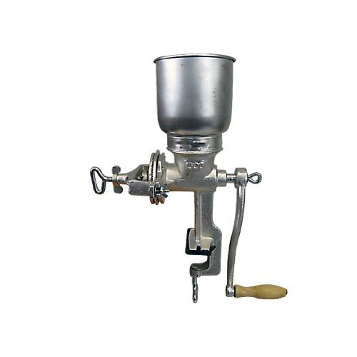
“Smart” Computers: Algorithms
D a t a
  Large genomic data → disease process knowledge
  Customer data → Recommendations for books/movies
D a t a
D a t a
New
Information
Essence: Get new Information from Data

Slide 11
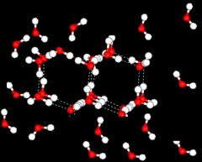
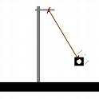
Sciences: Changed by Computers
“Simulations” are replacing “Experiments”
Link1
Link2
Link3

Slide 12
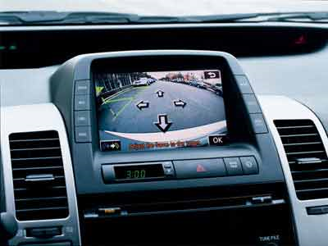
Self-Parking/Driving Cars
(Of course, by a Computer!)
VW Tiguan parks itself (by a computer)!
BMW taken into garage by a computer
Lexus LS460 – Parallel Park in Boston
DARPA Urban Challenge – (“Junior”)
OnStar Road Service by GM

Slide 13
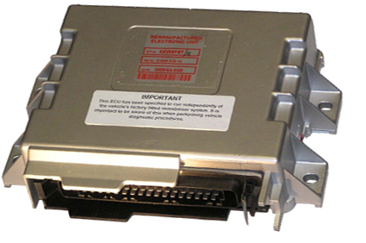
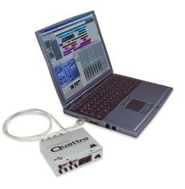
Engine Control Unit : Programmable Car
ECU
Reprogramming your car’s computer
Computer Chip Based Car Engine
Modifying the program to control the engine

Slide 14
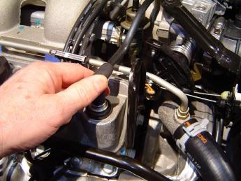
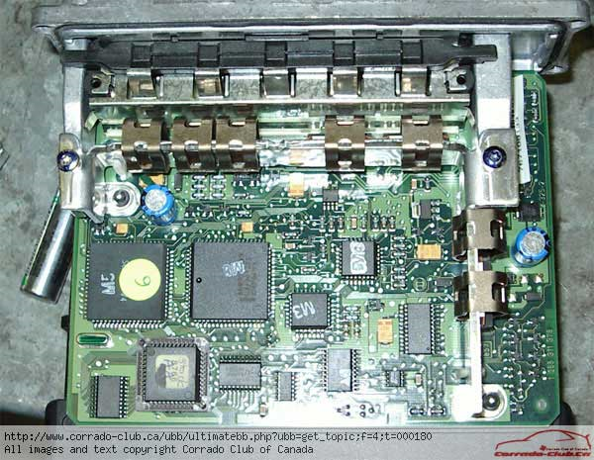
A Computer hidden in Each modern Car
Emission Control
The Old Way
PCV valves (1960)
Evaporative ECS (‘71)
Catalytic Converter (‘74)
The New Way
On-Board Diagnostic “OBD-II” (1994)

Slide 15
OBD-II: What Does it Do?
Oxygen Sensor
Air Pressure
Air Temperature
Engine Temperature
Throttle Position
Knock Sensor
Fuel Injectors
Spark Plugs
Idle Speed
“Check Engine” Light
OBD-II
Engine Diagnostic Using OBD-II

Slide 16
Other Computers in Cars
One Computer to Control Automatic Transmission
Computer to control Anti-Lock-Brakes
  Constantly reading all wheel speeds
Airbag systems have their own computers
Keyless entry/security system has its own computer
Climate control system has its own computer
Entertainment system has its own computer
Cruise Control has a computer
Seats with memory have a computer
Sensors monitor blind spots and inform driver

Slide 17
Automating Automobiles
Goal: An automated Highway System
  Computers maintain inter-car distance in a lane
  Cars within 100 yards talk to each other 50 times every second
    Keep themselves ordered and behaved on the highway
    Avoid accidents
    Maintain highest traffic throughput
  Highway status is communicated to all cars within 50 miles
  Lane-boundaries are marked by magnets and detected by cars

Slide 18
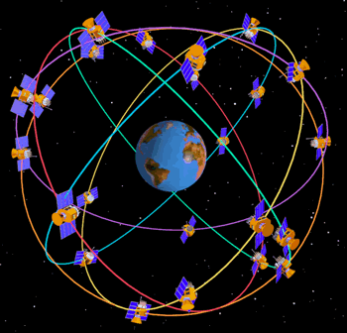
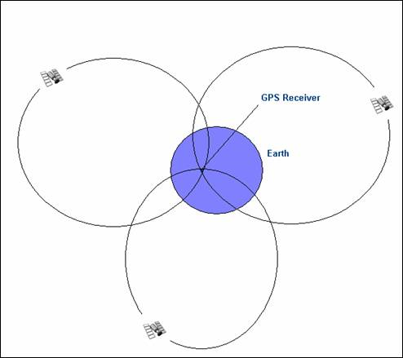
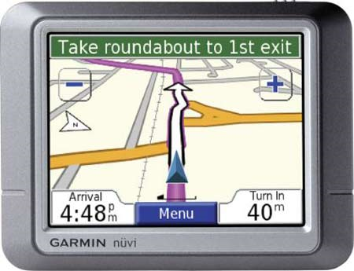
GPS System
Find the shortest path in a map
Calculate its own position
Find directions to destination

Slide 19
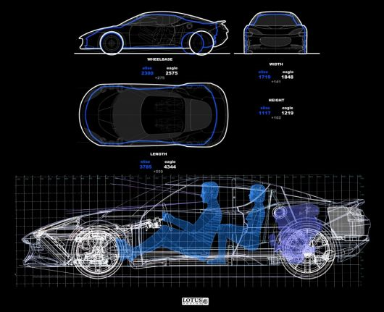
Computer Aided Design of Automobiles
CAD systems for designing and testing models
UGS solid-line system
Virtual Wind Tunnel
Virtual Wind Tunnel-2
Virtual Wind Tunnel-3
CAD Design Tools

Slide 20

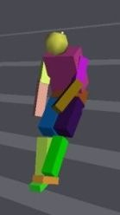
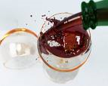
Simulations in Physics
An Ideal Gas Simulation
A Circuit Simulation
Physics Simulations
Water Molecules
Freezing Dynamics of Water
Cellular Process Simulation
Robocup 2007 Soccer
Robocup 2009 Soccer
Robocup 2011 Soccer
Robocup 2012 Soccer

Slide 21
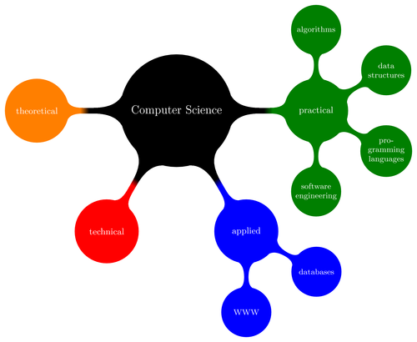
Impacts of Computer Science/Engineering
Visualization Systems at Microscopic Levels
Explosion Simulation
What is Computer Science/Engineering?
Why do Computer Science/Engineering?
Things CS Researchers want to understand

Slide 22
Robot – An Intelligent Agent
Solving “Path Planning” Problem
Robot
Sensors:
Light, Infrared, touch
Environment
Knowledge,
Reasoning, Learning
Actuators: Motors,
motion-parts
Example Scenarios:
http://msl.cs.uiuc.edu/~lavalle/cs576_2000/Tan/final.html
Crawling Robot
RISE: crawling robot

Slide 23
Planning by Robots – More Complex Tasks
Manufacturing
  Towel Folding Robot ; Car Factory - Kia
Surgery
  Suturing a Grape
  surgery demonstration
Playing Soccer
  http://www.youtube.com/watch?v=ICgL1OWsn58
  Example-2: RoboCup 2009
  Requires LEARNING opposition teams’s strategy
DARPA Challenge
  http://www.darpa.mil/grandchallenge/video/DARPA_highlight_preview3.wmv

Slide 24
- Robots with a mind of their own
Reassembling Module
Inspired by Animals
Cooperative Transport
Robocup 2009 – rollers
rollers2
Surgery 2
Surgery 3
Playing Violin
- IBM’s Watson

